Slide 1

My Data Interactive Notebook
Name
Class
Teacher
Semester 2
Term 3
1

Slide 2

Interactive Notebooks!
Cover Page
Contents Page
Glossary
24/7/30
EQ
Questions
Notes
Summaries
Work page
Presentation!!!
Your book, your responsibility!

Slide 3


Slide 4
With that in mind, let’s get ready for our Semester 2 exam...

Slide 5
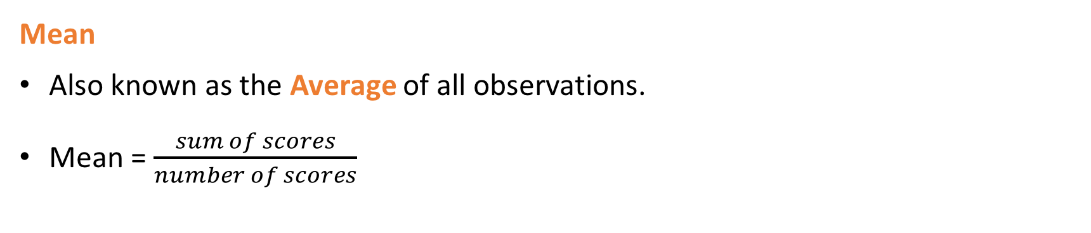
24
7
30
Measures of Location
Date
EQ – What have we learned about data, equations and time?
What are the main measures of
location and spread?
The three most common measures of location are the mean, the median, and the mode. The measure of spread we use is called the range.
Mean
Also known as the Average of all observations.
Mean = $\frac{sum of scores}{number of scores}$
Median – This is the middle value if the values are in order. If there are two middle values then add them together and divide by 2.
Mode = The value that occurs the most
Range = The maximum value – the minimum value

Slide 6
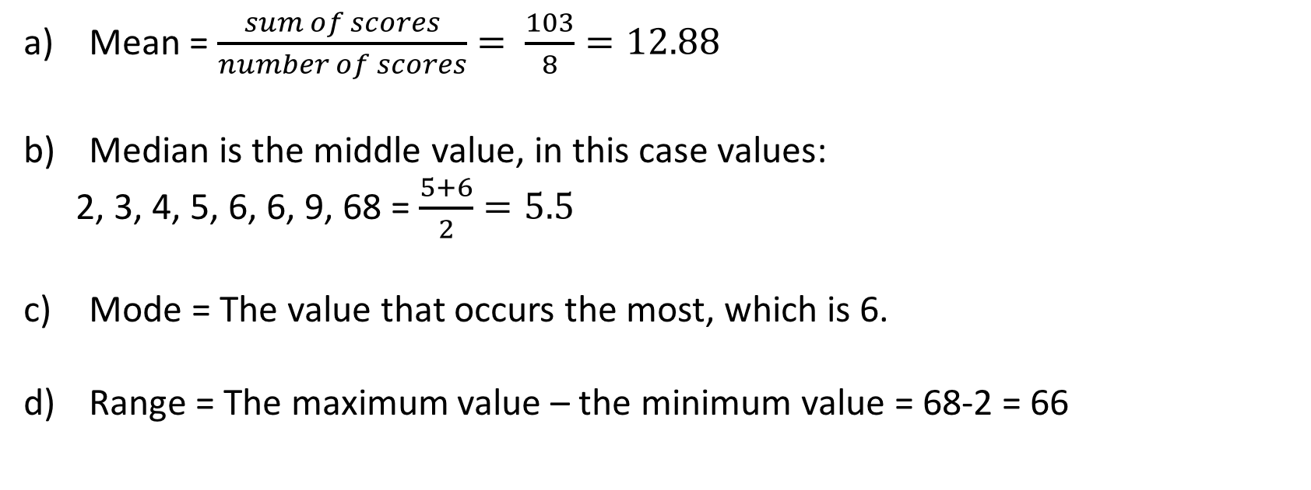
24
7
30
Measures of Location
Date
EQ – What have we learned about data, equations and time?
Find the mean, median, mode and rage of the following: 2, 3, 4, 5, 6, 6, 9, 68
Mean = $\frac{sum of scores}{number of scores}= \frac{103}{8}=12.88$
Median is the middle value, in this case values:
2, 3, 4, 5, 6, 6, 9, 68 = $\frac{5+6}{2}=5.5$
Mode = The value that occurs the most, which is 6.
Range = The maximum value – the minimum value = 68-2 = 66

Slide 7
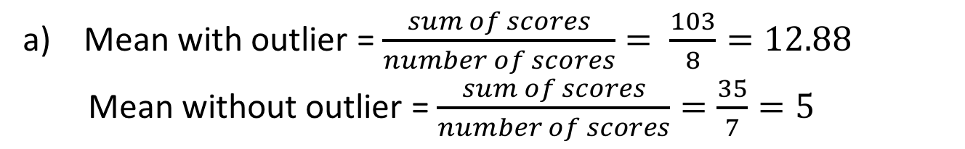
24
7
30
Measures of Location
Date
EQ – What have we learned about data, equations and time?
What are outliers?
Find the mean, median, mode and rage of the following: 2, 3, 4, 5, 6, 6, 9, 68
What number is unusual in the above set of numbers?
We call 68 an outlier. Outliers are unusual values and we need to know how the affect our measures of location and spread.
Let’s look at how removing the outlier affects the mean for the above set of numbers:
68!
Mean with outlier = $\frac{sum of scores}{number of scores}= \frac{103}{8}=12.88$
Mean without outlier = $\frac{sum of scores}{number of scores}=\frac{35}{7}=5$
Quite a difference

Slide 8
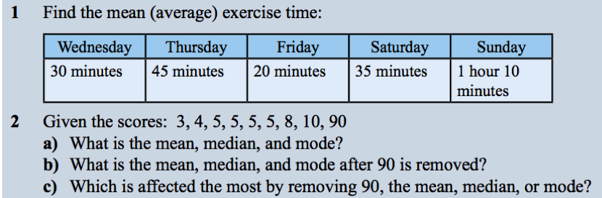
Your Turn:

Slide 9

Date
24
7
30
Solving Equations
EQ – What have we learned about data, equations and time?
To solve an equation with a variable, we rearrange the equation so our unknown value is by itself on one side of the equals sign. If you do something on one side of the equals sign, do it on the other! We do this by doing the inverse action.
x + 2 = 4
Think: Inverse of + is -
x + 2 = 4
-2 -2
x = 2
CHECK YOUR ANSWER!!
2+2=4
x ÷ 3 = 4
Think: Inverse of ÷ is x
x ÷ 3 = 4
x3 x3
x = 12
CHECK YOUR ANSWER!!
12 ÷ 3 = 4
The inverse functions are:
+ -
+
x ÷
÷ x
If you do something on one side of the equals sign, do it on the other!

Slide 10
24
7
30
Solving Multi-step Equations
Date:
EQ – What have we learned about data, equations and time?
C type Questions
n + 4 = 9
5 + k = 14

Slide 11
24
7
30
Solving Two-Step Algebraic Equations
Date
EQ – What have we learned about data, equations and time?
Solve: 3x + 4 = 16
Solving Two-Step
Equations
3x + 4 = 16
-4 -4
Undo Addition or Subtraction 1st
3x = 12
3
3
Undo Multiplication or Division 2nd
x = 4

Slide 12
24
7
30
Solving Multi-step Equations
Date:
C type Questions
EQ – What have we learned about data, equations and time?
3n + 1 = 13
5k - 3 = 27
6a + 3 = 21

Slide 13
24
7
30
Solving Multi-Step Algebraic Equations
Date
EQ – What have we learned about data, equations and time?
FIRST - Use the Distributive Property to get rid of the parentheses.
Example: 3 ( x – 2 ) + 4x = 8
SECOND: Combine like terms.
3x
– 6
+ 4x = 8
Copy the rest of the problem.
7x
– 6 = 8
+ 6 + 6
Add 6 to both sides.
Now it’s a regular 2-step equation.
7x = 14
Divide both sides by 7.
7 7
x = 2

Slide 14
24
7
30
Solving Multi-step Equations
Date:
B type Questions
EQ – What have we learned about data, equations and time?
2(3f – 1) = 21
2(4 -2s) = 22
7(2 -3w) = 56

Slide 15
24
7
30
Solving Multi-step Equations
Date:
A type Questions
EQ – What have we learned about data, equations and time?
4(2a - 1) = 3(a + 2)
6(c - 5) = 5(c - 4)

Slide 16
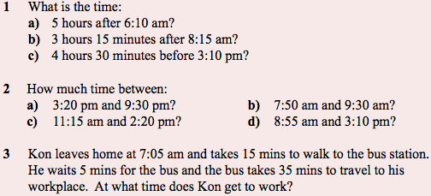
Answer the following from last lesson:

Slide 17
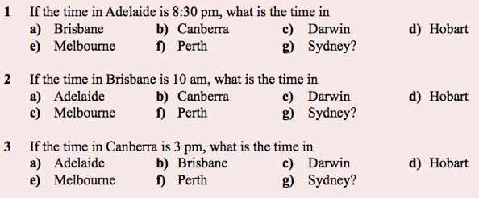

Slide 18
24
7
30
Measures of Location
Date
EQ – What are outliers and how do they affect the measures of location and spread we’ve learned about?
What are outliers?
Outliers are unusual values. When we see outliers, we need to find out:
Are they mistakes
Should we delete them
Complete your Summary!!!
Summary:

Slide 19
Notes Review
24, 7 ,30
Date
Title
Essential question
Notes complete
Notes complete with colour and diagrams
Questions completed
Contents page filed in
Formula page filled in

